Slide 1
OA3103: Data Analysis
Simple Linear Regression: Applications in Python and R

Slide 2
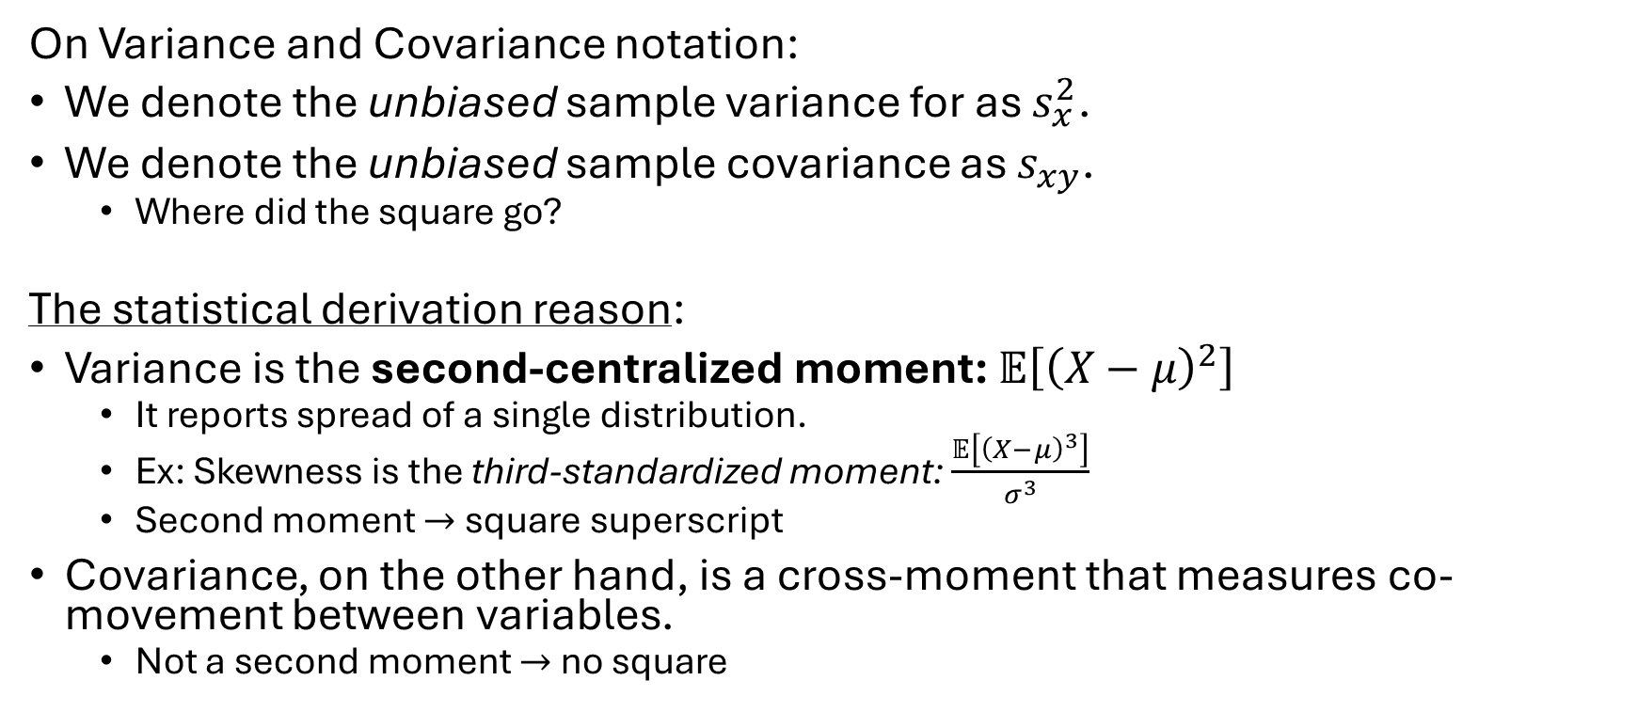
Follow-up From Yesterday #1
On Variance and Covariance notation:
We denote the unbiased sample variance for as $s_{x}^{2}$.
We denote the unbiased sample covariance as $s_{xy}$.
Where did the square go?
The statistical derivation reason:
Variance is the second-centralized moment: $𝔼\left[{\left(X−μ\right)}^{2}\right]$
It reports spread of a single distribution.
Ex: Skewness is the third-standardized moment: $\frac{𝔼\left[{\left(X−μ\right)}^{3}\right]}{σ^{3}}$
Second moment $→$square superscript
Covariance, on the other hand, is a cross-moment that measures co-movement between variables.
Not a second moment $→$ no square

Slide 3
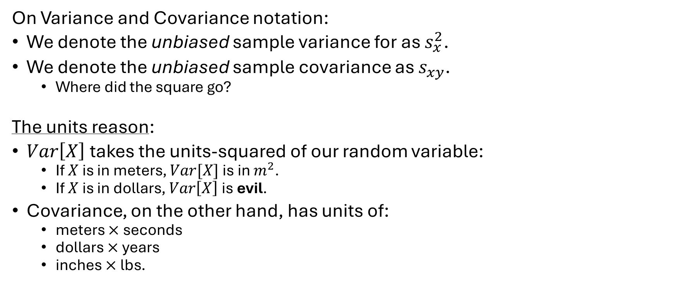
Etymology of notation
On Variance and Covariance notation:
We denote the unbiased sample variance for as $s_{x}^{2}$.
We denote the unbiased sample covariance as $s_{xy}$.
Where did the square go?
The units reason:
$Var\left[X\right]$takes the units-squared of our random variable:
If $X$ is in meters, $Var[X]$ is in $m^{2}$.
If $X$ is in dollars, $Var\left[X\right]$ is evil.
Covariance, on the other hand, has units of:
meters $×$ seconds
dollars $×$ years
inches $×$lbs.

Slide 4
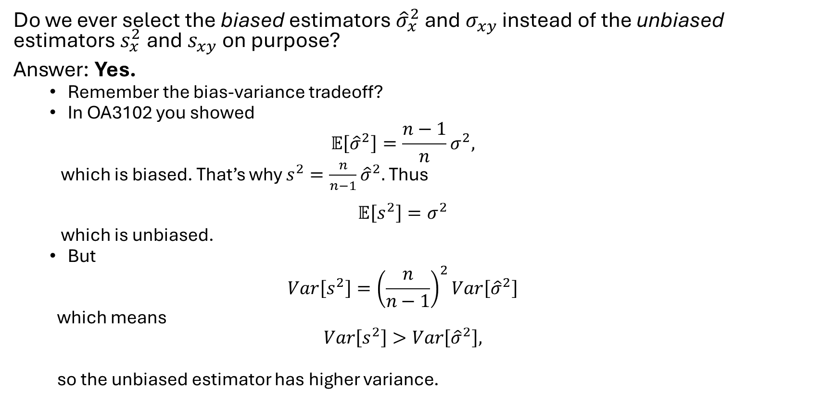
Follow-up From Yesterday #2
Do we ever select the biased estimators ${\hat{σ}}_{x}^{2}$ and $σ_{xy}$ instead of the unbiased estimators $s_{x}^{2}$and $s_{xy}$ on purpose?
Answer: Yes.
Remember the bias-variance tradeoff?
In OA3102 you showed
$$𝔼\left[{\hat{σ}}^{2}\right]=\frac{n−1}{n}σ^{2},$$
which is biased. That’s why $s^{2}=\frac{n}{n−1}{\hat{σ}}^{2}.$ Thus
$$𝔼\left[s^{2}\right]=σ^{2}$$
which is unbiased.
But
$$Var\left[s^{2}\right]={\left(\frac{n}{n−1}\right)}^{2}Var\left[{\hat{σ}}^{2}\right]$$
which means
$$Var\left[s^{2}\right]>Var\left[{\hat{σ}}^{2}\right],$$
so the unbiased estimator has higher variance.

Slide 5
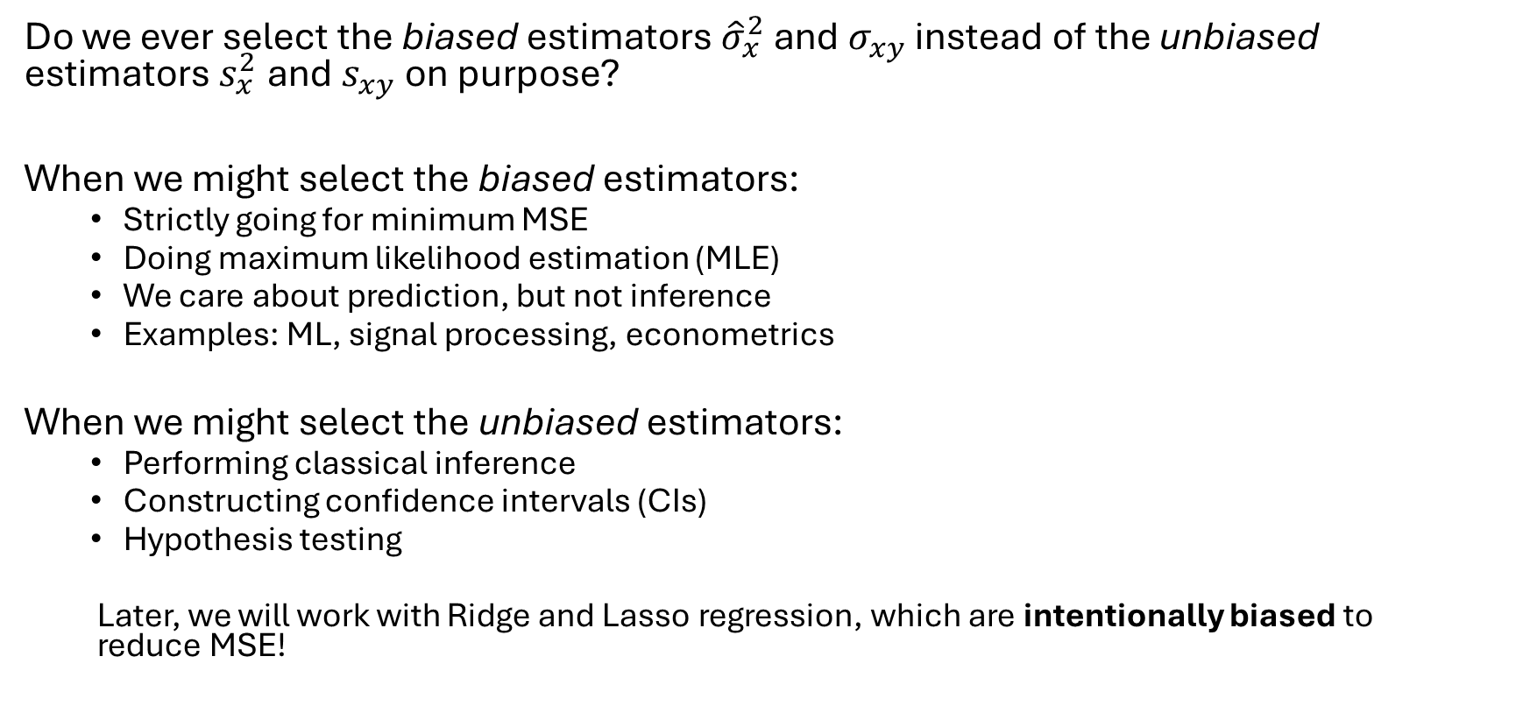
Biased vs Unbiased Estimators
Do we ever select the biased estimators ${\hat{σ}}_{x}^{2}$ and $σ_{xy}$ instead of the unbiased estimators $s_{x}^{2}$and $s_{xy}$ on purpose?
When we might select the biased estimators:
Strictly going for minimum MSE
Doing maximum likelihood estimation (MLE)
We care about prediction, but not inference
Examples: ML, signal processing, econometrics
When we might select the unbiased estimators:
Performing classical inference
Constructing confidence intervals (CIs)
Hypothesis testing
Later, we will work with Ridge and Lasso regression, which are intentionally biased to reduce MSE!
Notes:
Bottom line: “bias” shouldn’t have a stigma attached to it. The unbiased estimator is indeed unbiased by its mathematical definition… but it is not always best.

Slide 6

Biased vs Unbiased Estimators
Variance and Covariance Defaults in R and Python- It turns out different packages use different calculations for $Var$ and $Cov$:
Ecosystem / Package | Variance Code / Default Setting | Covariance Code/ Default Setting | Reasoning
R (base) | var | cov | Classical statistics; inference-oriented
 | Unbiased (n-1) | Unbiased (n-1)
Python/Pandas | Series.var | DataFrame.cov | Classical statistics defaults
 | Unbiased (n-1) | Unbiased (n-1)
Python/NumPy | np.var | np.cov | Numerical linear algebra roots; MLE for
 | Biased (n) | Unbiased (n-1) | variance, known historical inconsistency
Python/sklearn | Biased (n)* | Biased (n)* | ML-oriented; optimization over inference, MLE
Python/statsmodels | Unbiased (n-1)* | Unbiased (n-1)* | Designed to mirror R; inference oriented.
*internally: no specific code to calculate variance/covariance

Slide 7
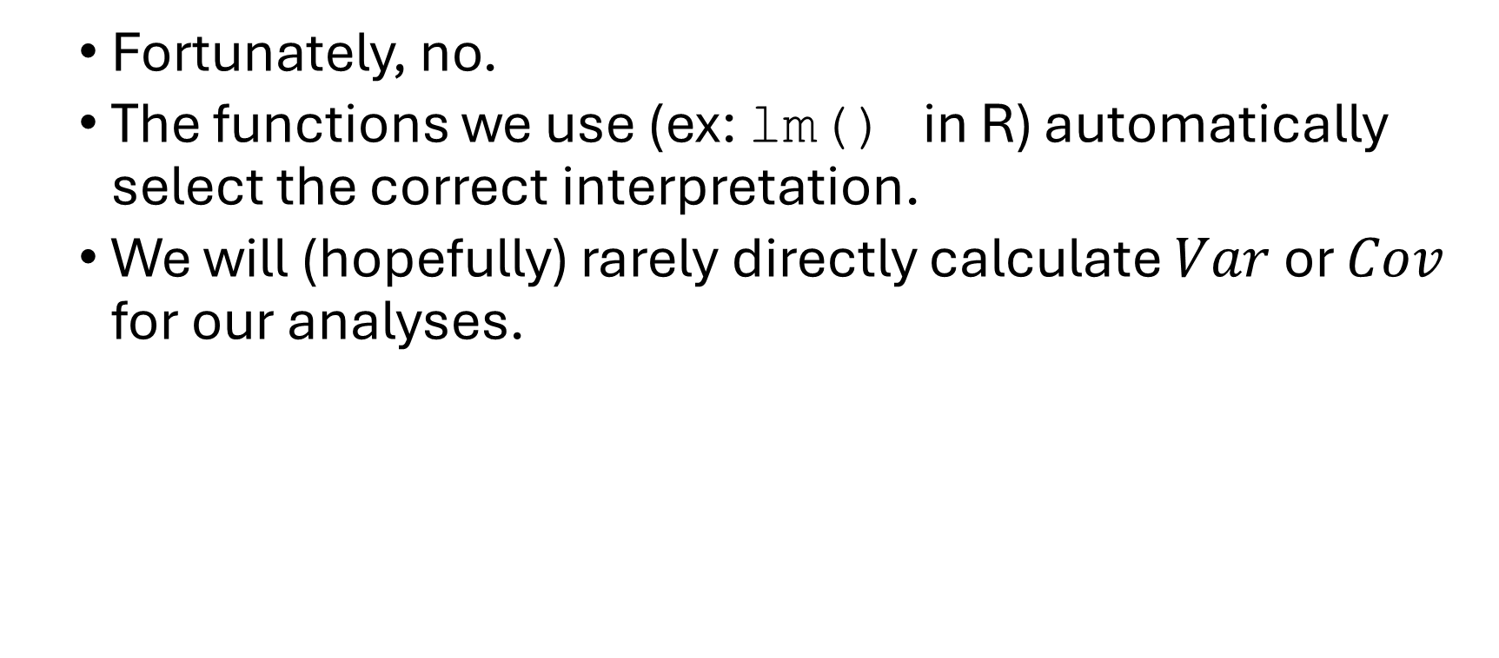
Do we need to mindfully select the correct package in R and/or Python?
Fortunately, no.
The functions we use (ex: lm() in R) automatically select the correct interpretation.
We will (hopefully) rarely directly calculate $Var$ or $Cov$ for our analyses.

Slide 8

Follow-up From Yesterday #3
How does covariance between observed $x_{i}$ and $y_{i}$ affect the slope parameter $β_{1}$?
Explore the Slope vs Cov and Var.ipynb file in Sakai.

Slide 9
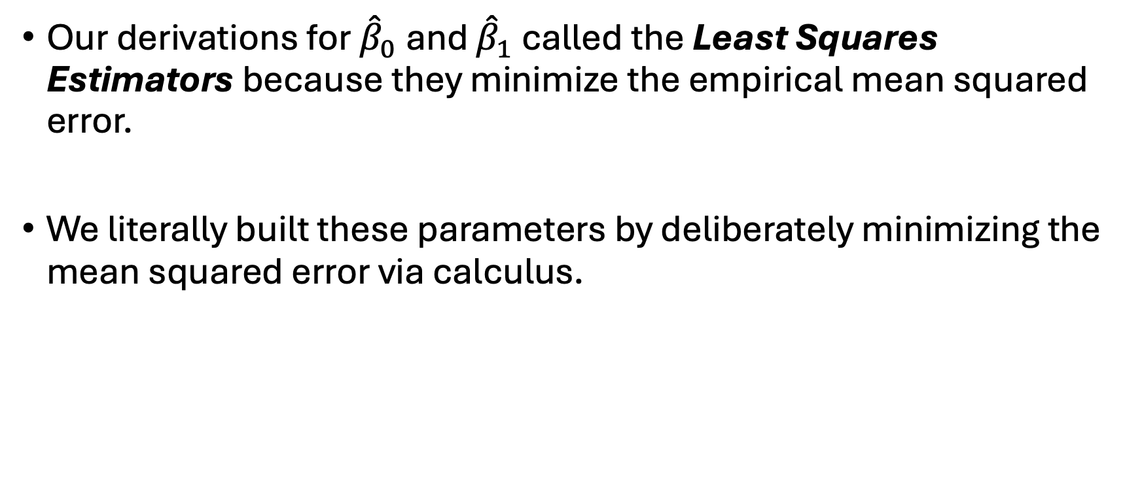
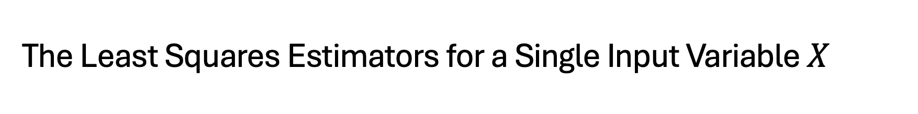
The Least Squares Estimators for a Single Input Variable $X$
Our derivations for ${\hat{β}}_{0}$ and ${\hat{β}}_{1}$ called the Least Squares Estimators because they minimize the empirical mean squared error.
We literally built these parameters by deliberately minimizing the mean squared error via calculus.

Slide 10

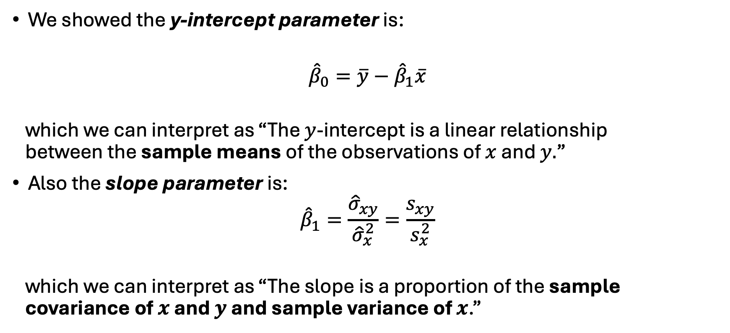
Interpretation of ${\hat{β}}_{0}$ and ${\hat{β}}_{1}$ for SLR
We showed the y-intercept parameter is:
$${\hat{β}}_{0}=\overline{y}−{\hat{β}}_{1}\overline{x}$$
which we can interpret as “The $y$-intercept is a linear relationship between the sample means of the observations of $x$ and $y.$”
Also the slope parameter is:
$${\hat{β}}_{1}=\frac{{\hat{σ}}_{xy}}{{\hat{σ}}_{x}^{2}}=\frac{s_{xy}}{s_{x}^{2}}$$
which we can interpret as “The slope is a proportion of the sample covariance of $x$ and $y$ and sample variance of $x$.”
Notes:
The slope is:
How much $y$changes, on average, for a one‑unit change in $x$.
And the formula
${\hat{β}}_{1}=\frac{s_{xy}}{s_{x}^{2}}$
tells us why:
The numerator $s_{xy}$measures how $x$and $y$move together.
The denominator $s_{x}^{2}$measures how much $x$varies on its own.
So the slope is:
The amount of co‑movement between $x$and $y$, scaled by how much $x$varies.
Also, the sign is dependent on the covariance.

Slide 11
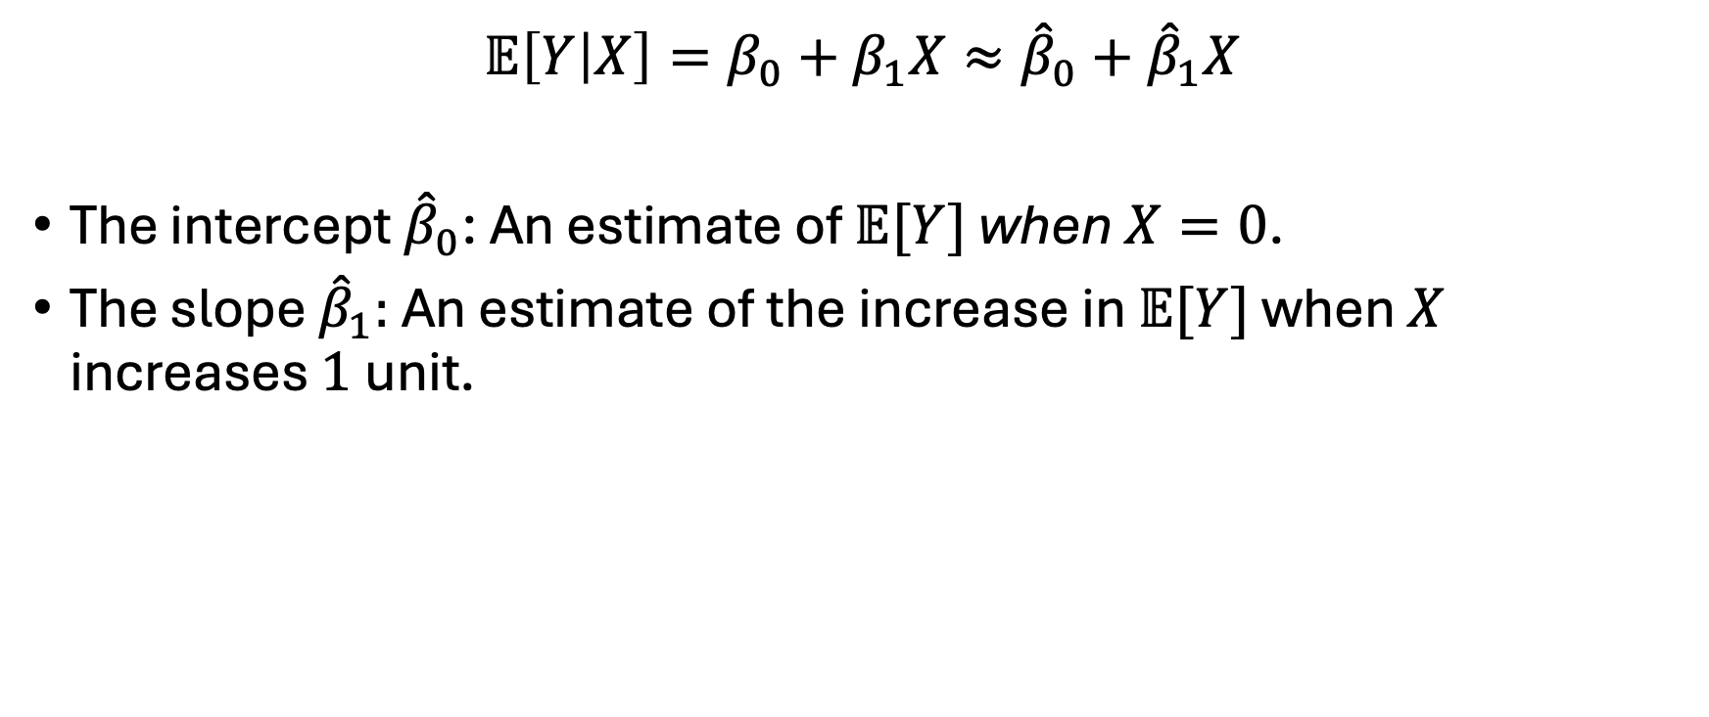
Interpretation of ${\hat{β}}_{0}$ and ${\hat{β}}_{1}$ for SLR
$$𝔼\left[Y | X\right]=β_{0}+β_{1}X≈{\hat{β}}_{0}+{\hat{β}}_{1}X$$
The intercept ${\hat{β}}_{0}$: An estimate of $𝔼[Y]$ when $X=0$.
The slope ${\hat{β}}_{1}:$ An estimate of the increase in $𝔼[Y]$ when $X$ increases $1$unit.

Slide 12
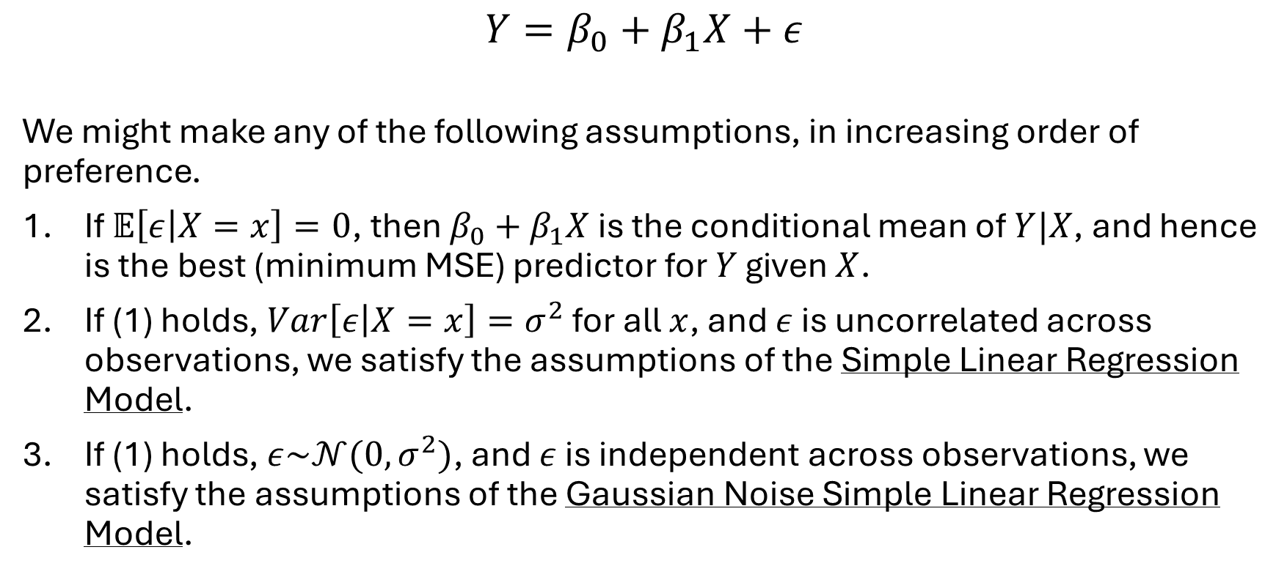
Some Common Assumptions
$$Y=β_{0}+β_{1}X+ε$$
We might make any of the following assumptions, in increasing order of preference.
If $𝔼\left[ε | X=x\right]=0$, then $β_{0}+β_{1}X$ is the conditional mean of $Y|X$, and hence is the best (minimum MSE) predictor for $Y$ given $X$.
If (1) holds, $Var\left[ε | X=x\right]=σ^{2}$ for all $x$, and $ε$ is uncorrelated across observations, we satisfy the assumptions of the Simple Linear Regression Model.
If (1) holds, $ε\sim 𝒩(0,σ^{2})$, and $ε$ is independent across observations, we satisfy the assumptions of the Gaussian Noise Simple Linear Regression Model.

Slide 13
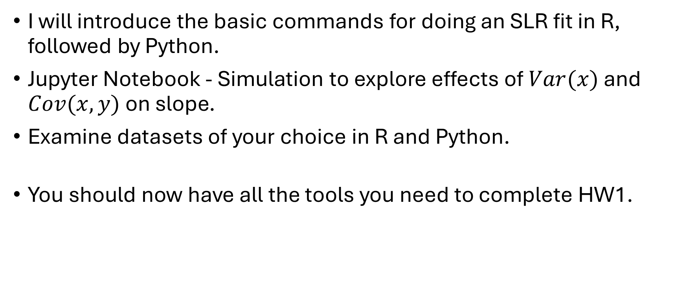
Back to R and Python
I will introduce the basic commands for doing an SLR fit in R, followed by Python.
Jupyter Notebook - Simulation to explore effects of $Var(x)$ and $Cov(x,y)$ on slope.
Examine datasets of your choice in R and Python.
You should now have all the tools you need to complete HW1.

